Slide 1



An introduction to infectious disease modelling
Shanghai, 12-14 August 2019

Slide 2






Sponsor statement
Sponsors:
NIHR Global Health Research Group on Evidence to Policy pathway to Immunisation in China (NIHR EPIC)
NIHR EPIC will “conduct applied vaccine research to help decision makers in China build a vaccination programme that ensures reliable, affordable, equitable and uninterrupted supply of vaccines to the Chinese population”.
Over 3 years (1 Aug 2017 – 31 July 2020) and £1.6 million funding from NIHR (with support in kind from Fudan University and China CDC).

Slide 3
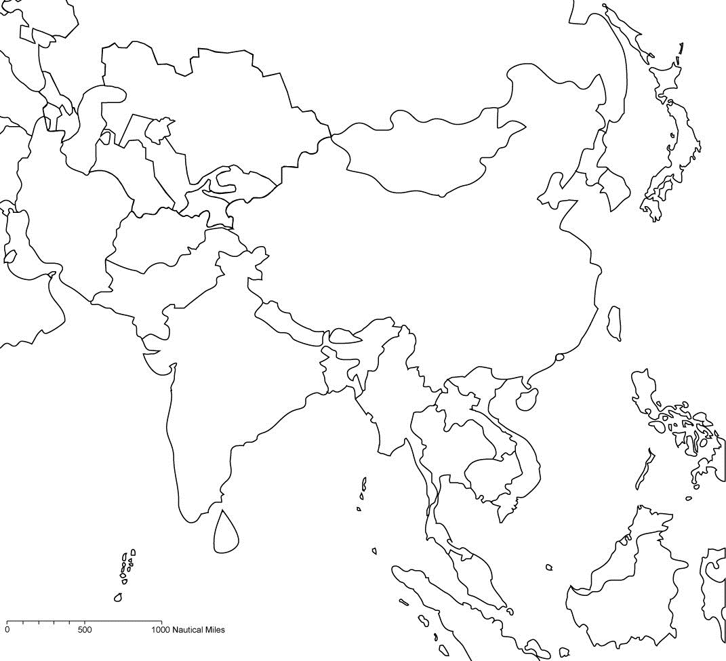





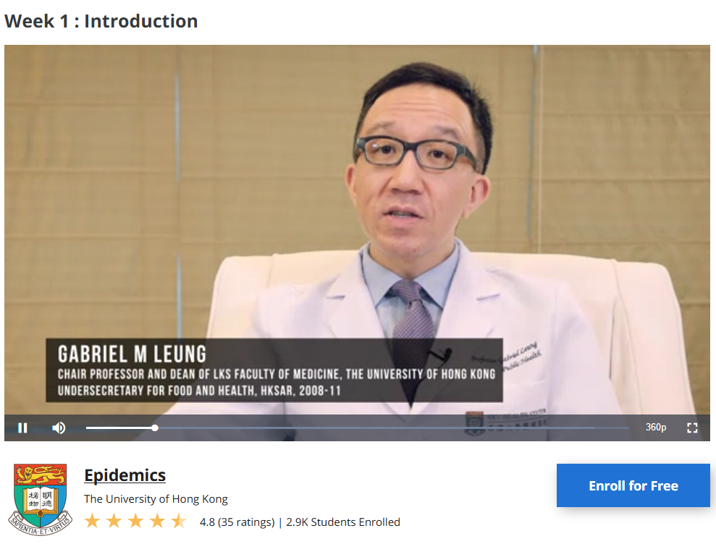





Ulaanbaatar 2013
Vaccine economics-related courses co-organised by LSHTM
Beijing 2012
Vaccinology
Health economics
Infectious disease modelling
Shanghai 2019
Delhi 2019 planned
Hong Kong 2011
Hong Kong 2016, 2018
Online (Coursera MOOC) with HKU since 2014
Bangkok 2012, 2017
Ho Chi Minh City 2016
Ho Chi Minh City 2017
Kuala Lumpur 2014
Singapore 2013, 2015

Slide 4




Slide 5
Course participants
Others: Southeast University, Xi'an Jiaotong University, Nanjing Medical University, Binzhou Medical University, China Center for Health Economic Research, University of Melbourne, University of Hong Kong, China National Health Development Research Center, Southern Medical University, Huazhong University of Science and Technology, Tianjin Medical University, Shantou University, MicroStat (China) Ltd., Sichuan University, Xinjiang Medical University, Shandong University, Shanghai Health Development Research Center, Shanghai Jiaotong University
Notes:
data1=c("Fudan\nUniversity",18,
"China Center\nfor Diseaese Control\nand Prevention",16,
"Sun Yat-Sen\nUniversity",7,
"Peking\nUniversity",5,
"Center for\nTuberculosis Control\nof Guangdong Province",3,
"Xinjiang\nUniversity",3,
"Others",22)
data1m=matrix(data1, ncol=2, byrow=T)
par(mgp=c(2,2,0)) #minimise distance between axes and labels
barplot(height=as.numeric(data1m[,2]), names.arg=data1m[,1], col=rainbow(7))
box()

Slide 6

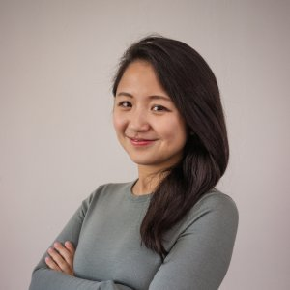






Course overview
Lecture 1: Introduction to Infectious disease modelling
Joseph Wu
Lecture 2: Introduction to R programming for infectious disease modelling
Yang Liu
Day 1
Aug 12
Practical 1: Simple Infectious disease modelling in Excel
Mark Jit
Practical 2: R programming exercise
Yang Liu
Practical 1: More complexx Infectious disease modelling in R
Kathy Leung
Lecture 3: Economics of infectious diseases
Mark Jit
Day 2
Aug 13
Case study: Modelling smallpox interventions
Joseph Wu
Practical 4: Economic evaluation of vaccination
Mark Jit
Lecture 4: Phylodynamic analysis
Tommy Lam
Lecture 5: Uses of infectious disease modelling in China
Hongjie Yu
Day 3
Aug 14
Practical 4: Phylodynamic analysis
Tommy Lam

